Slide 1
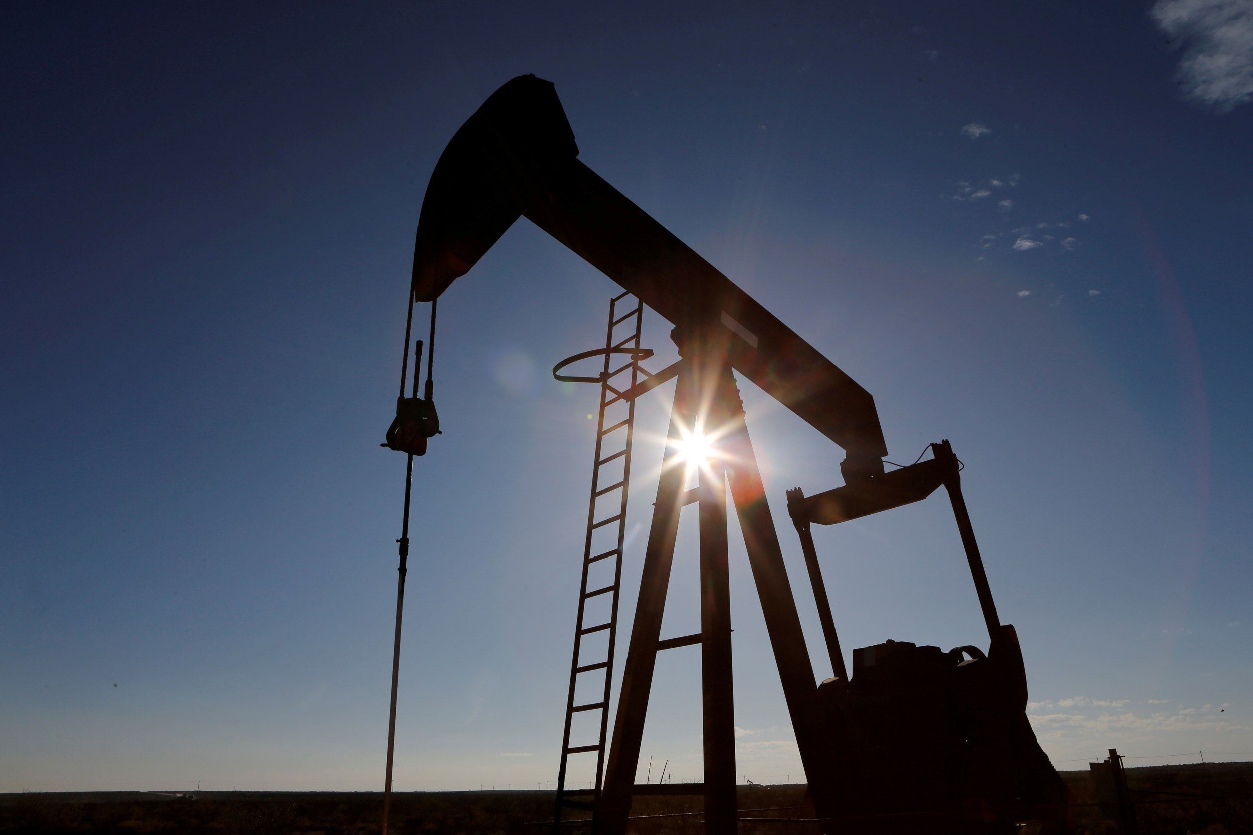

Crude Oil Data Set
ISDS 540
Group 1
Shirley Chow
Adrianna Godfrey
Vijeta Kodam
Kieu Tien Nguyen
Matthew Sanders

Slide 2

The goal of our project is to examine and understand the price of crude oil over time. Identify any patterns that exist, see if there is a relationship between future and past crude oil prices, and predict with a level of confidence what the price of crude oil will be for January 2014 using different statistical methods to see which method provides us with the most accurate prediction.
Goal

Slide 3
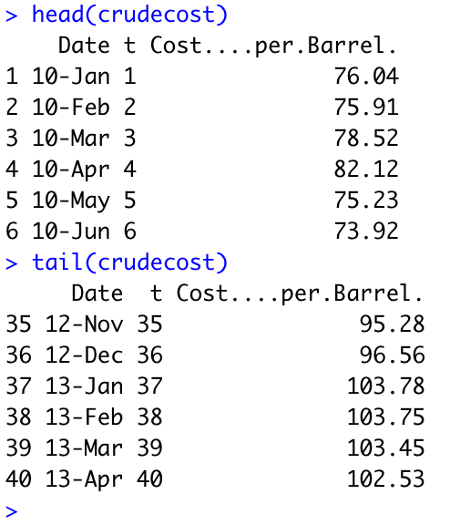
Crude Oil Data Set

Slide 4
Response Variables and Predictors
The predictor variable will be the time series variable (t). This variable is discrete as it represents the number of months since January 2010.
The response variable will be the cost of crude oil in dollars per barrel at a given point in time (t). This variable is continuous.

Slide 5
Statistical Methods Used
Descriptive Statistics
Interval Estimation with a 95% & 99% confidence level
Time Series Plot (horizontal, trend, seasonal)
Linear Trend Equation
Quadratic Trend Equation
Mean-Squared Error (MSE)
Notes:
Descriptive statistics to summarize our data. See if our data is normally distributed or not.
Interval estimation with a 95% & 99% confidence level to give us the parameter.
We will construct a time series plot to see if there is any pattern that exists in the data (horizontal, trend, seasonal?).
Compute the linear trend equation to forecast the crude cost for January 2014.
Compute the quadratic trend equation for time series to forecast the crude cost for January 2014 using dummy variables.
Use MSE to see which approach provides the most accurate forecasts, see if our inference is within our interval estimation.

Slide 6
Descriptive Statistics
Notes:
Scatterplot– are there any trends? Is it normally distributed? Shape of graph? Outliers?
Do we have any bias/sampling errors?
Find the mean median mode what does this tell us.

Slide 7
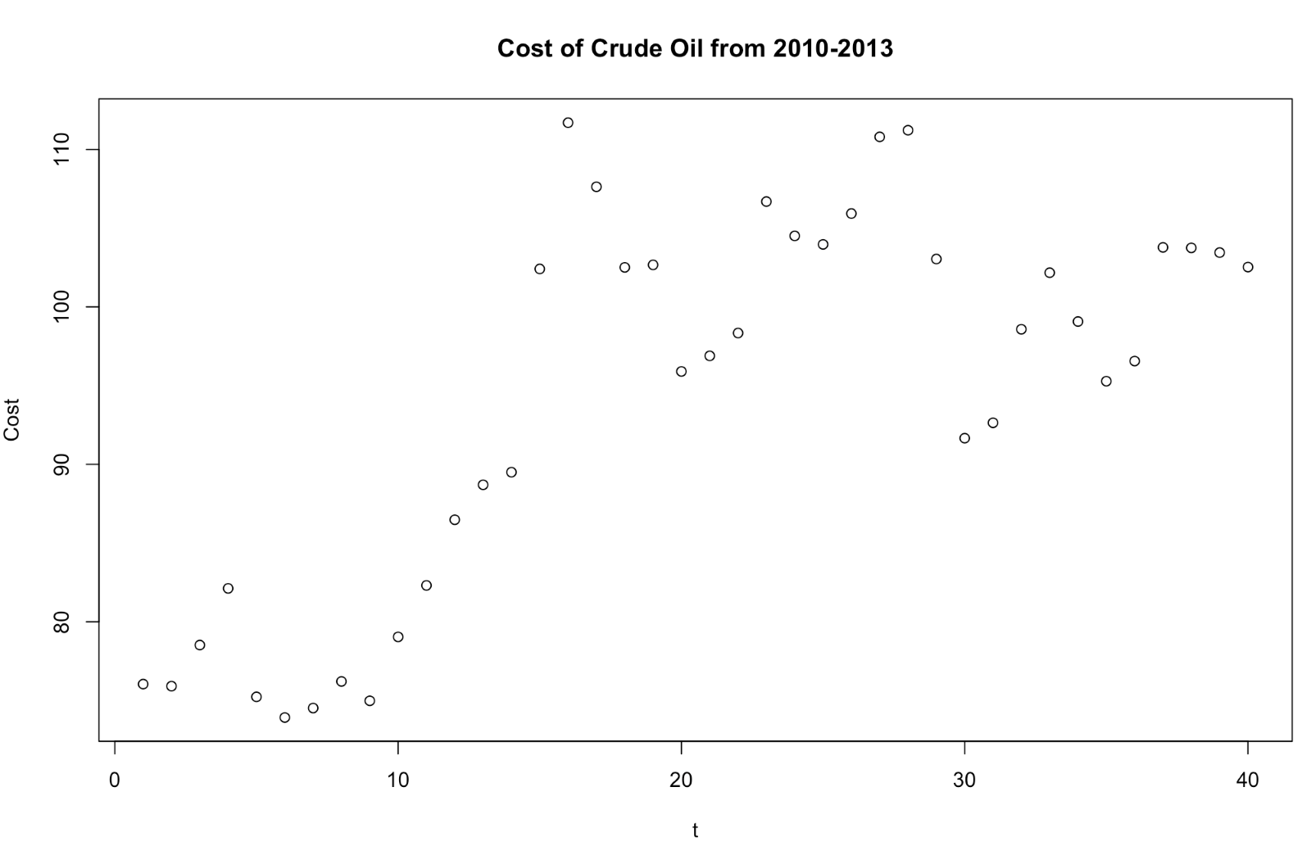
Mean: 94.179
Median: 97.615
Mode: No recurring prices
Range: 37.78
IQR: 21.2625
Variance: 146.4485
Standard Deviation: 12.10159
Coefficient of Variation: 12.84956

Slide 8
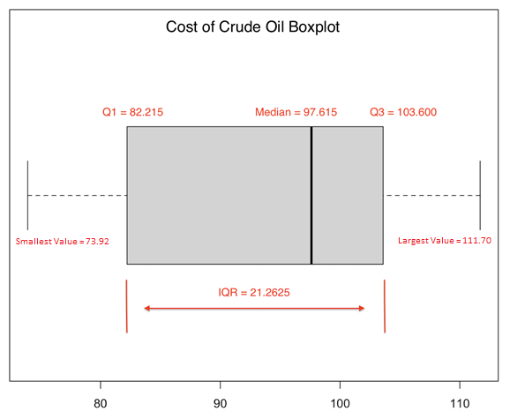
Mean: 94.179
Median: 97.615
Mode: No recurring prices
Range: 37.78
IQR: 21.2625
Variance: 146.4485
Standard Deviation: 12.10159
Coefficient of Variation: 12.84956

Slide 9
Interval Estimation (with 95% and 99% confidence)

Slide 10
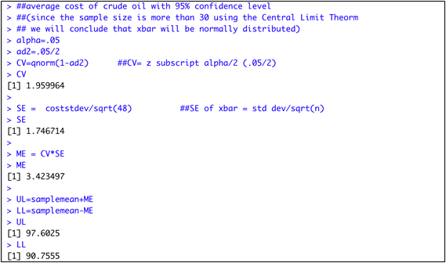
Average cost with 95% confidence level
Notes:
We are 95% confident that the average cost of crude oil is between $90.76 and $97.60

Slide 11
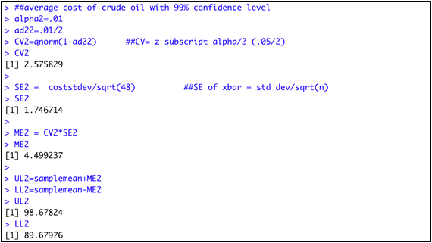
Average cost with 99% confidence level
Notes:
We are 99% confident that the average cost of crude oil is between $89.68 and $98.68

Slide 12
Time Series Plot
Notes:
Horizontal, trend, seasonal?– with this what form of analysis should we use to examine data
There is an increasing trend till t=16 and then it shows a trend of increasing and decreasing of the cost.

Slide 13
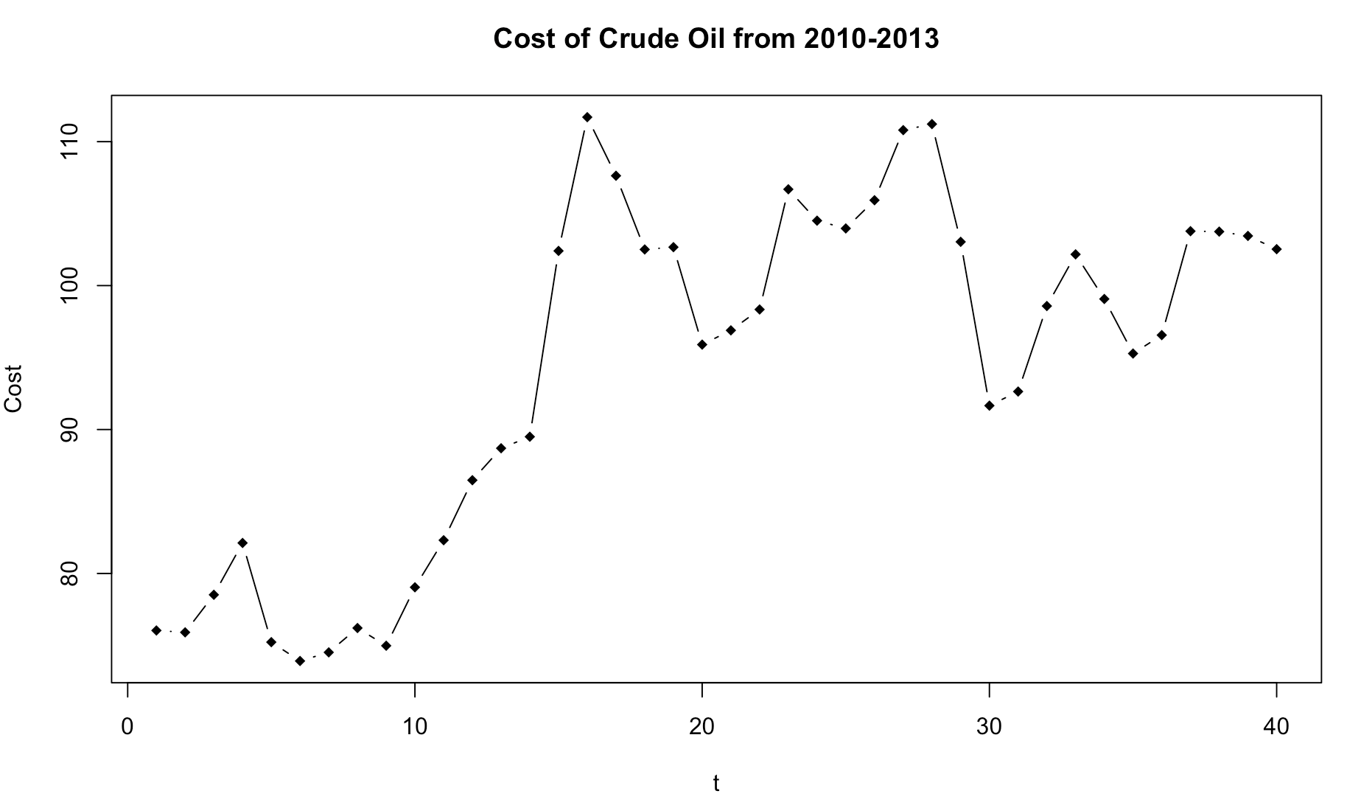

Slide 14
Linear Trend Equation

Slide 15
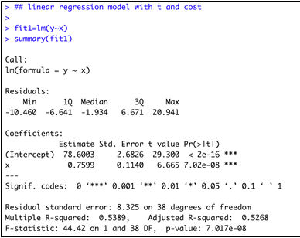
Linear Trend Equation:
Cost ($ per Barrel) = 78.600 + 0.7599t
Notes:
What is the linear trend equation? Is the model a good fit? What is the goodness of fit for this model?
Cost ($ per Barrel) = 78.600 + 0.7599t
We can say the linear model is not a good fit because if you were to plug in the number of months that are couple years out (for example, 1000 months), this would increase the crude cost over time, which is not a realistic situation. You can also see from the scatter plot that the graphs are not linear

Slide 16
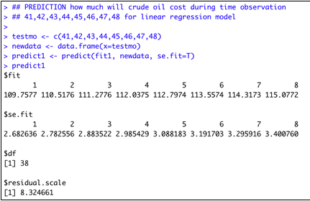
Cost of Crude Oil for May 2013 using the Linear Trend Equation
Cost of Crude Oil for May 2013:
78.600 + 0.7599(41) = $109.76
Notes:
How does this compare to the average cost found in number 2?
This result is outside both our 95% and 99% confidence intervals by nearly a full standard deviation.

Slide 17
Quadratic Trend Equation

Slide 18
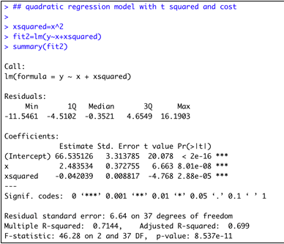
Quadratic Trend Equation:
Cost ($ per Barrel) = 66.54 + 2.484(t) – 0.04204(t)²
Notes:
What is the quadratic trend equation? Is the model a good fit? What is the goodness of fit for this model?
Cost ($ per Barrel) = 66.54 + 2.484 (t) – 0.04204 (t)²

Slide 19
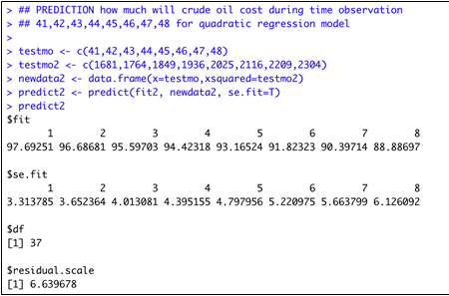
Cost of Crude Oil for May 2013 using the Quadratic Trend Equation
Cost of Crude Oil for May 2013:
66.54 + 2.484 (41) – 0.04204 (41)² = $97.69
Notes:
How does this compare to the linear trend equation? What observations can we make?
This value falls within our 95 and 99% estimation intervals as opposed to our linear model result, which is a value nearly a full standard deviation above that range.

Slide 20
Mean-Squared Error

Slide 21
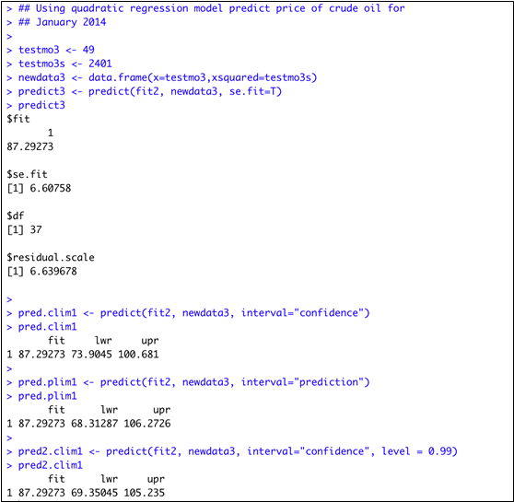
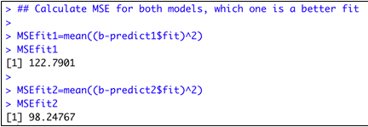
Which approach provides the most accurate forecast?
Notes:
Which model is a better fit for the given data?
The quadratic model has a lower mean squared error and therefore fits the model better than the linear model.
Reason when MSE looks larger after using a training and test set (40-8), instead of all 48
The first reason is that you used a smaller data set in your new models, as you pointed out. The second reason is that when using all 48 data points, your MSE was computed on the training data (which are all 48 data points) while your new MSEs were computed on the test data. In general, the MSE based on the training data is larger than the MSE based on the test data.
The second one is why we need to split the dataset into two parts (training and test). When picking up the model, we just choose the model with smaller MSE on the test data, which means that the model has better predictability.

Slide 22
In conclusion, we can determine that the quadratic trend equation is the best model for this crude oil data set, with the following reasons.
Based on descriptive statistics, the scatter plot does not represent a linear relationship
There is an increasing trend until the 16th month, where the trend starts to fluctuate Quadratic model is more reliable, as the results of using the model lies within the 95% and 99% confidence interval
Quadratic trend equation has a smaller MSE compared to linear trend equation
Conclusion
Notes:
We are 95% confident that the average cost of crude oil is between $90.76 and $97.60
We are 99% confident that the average cost of crude oil is between $89.68 and $98.68
There is an increasing trend till t=16 and then it shows a trend of increasing and decreasing of the cost.

